Slide 1
Control Theory(3nd)
By JunAng Wang
2023/12/01

Slide 2
Recap
Tuning PID Controller
Linear Quadratic Regulator
Data-Driven Control
Model Predictive Controller

Slide 3
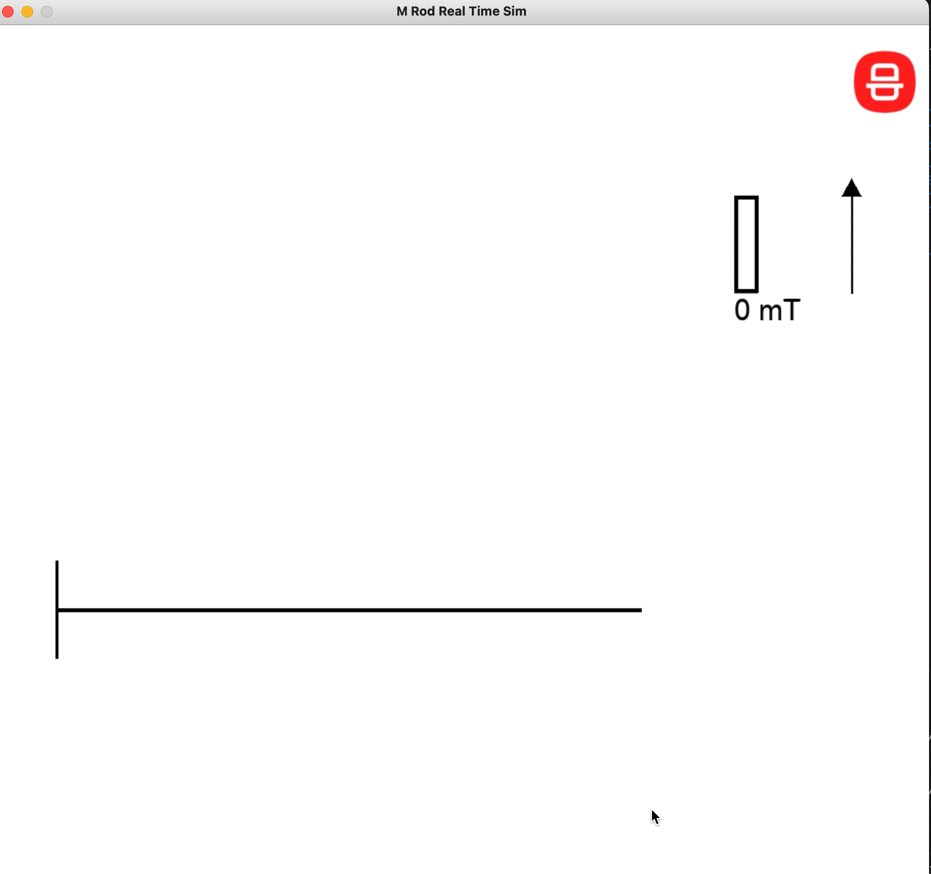
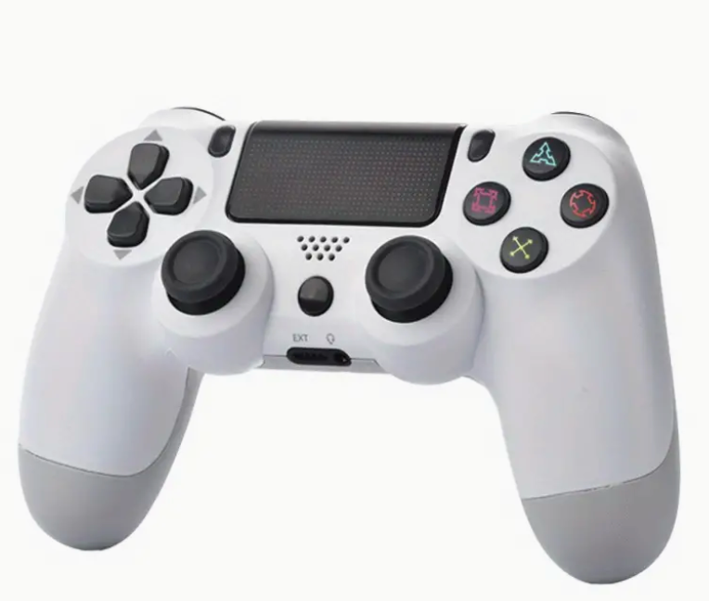
Quasi-Real-Time Simulator

Slide 4
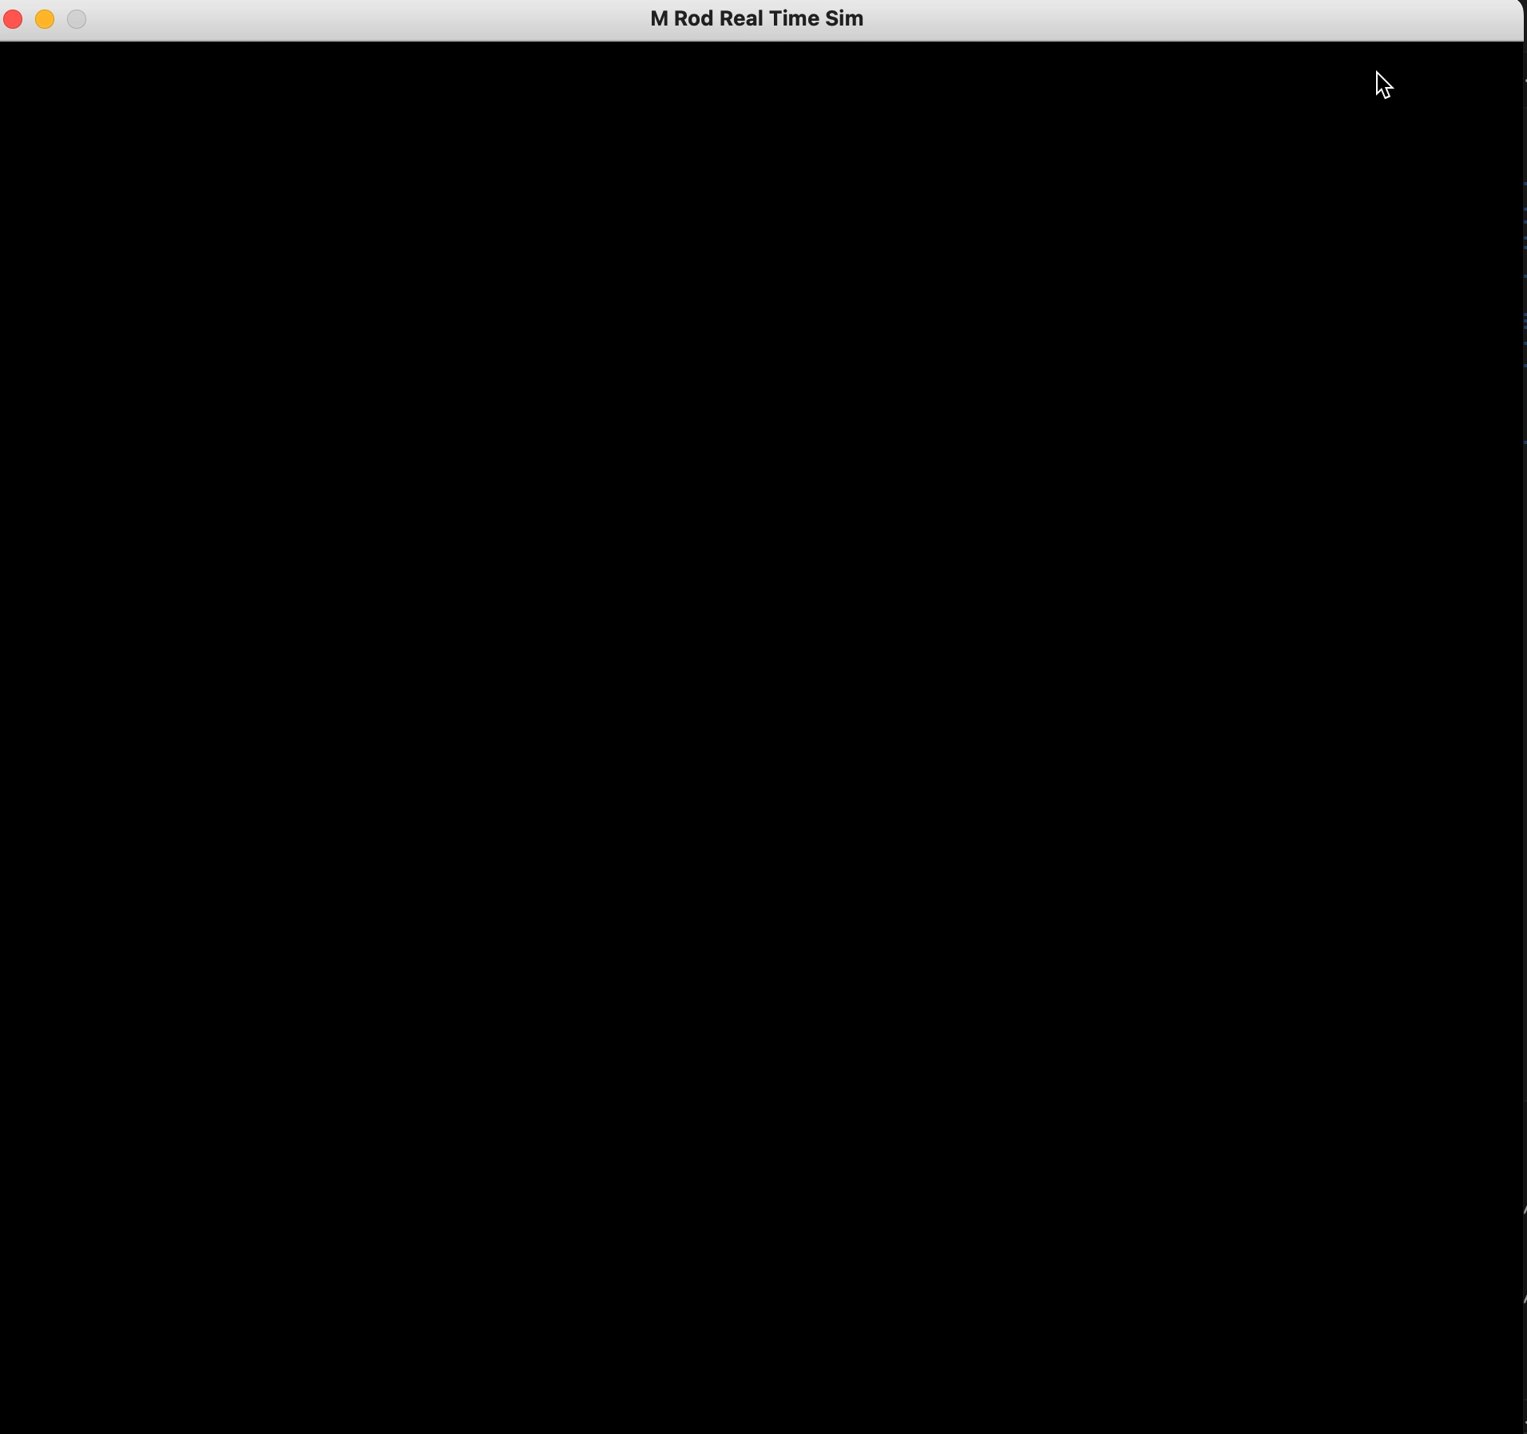

Tuning PID Controller

Slide 5
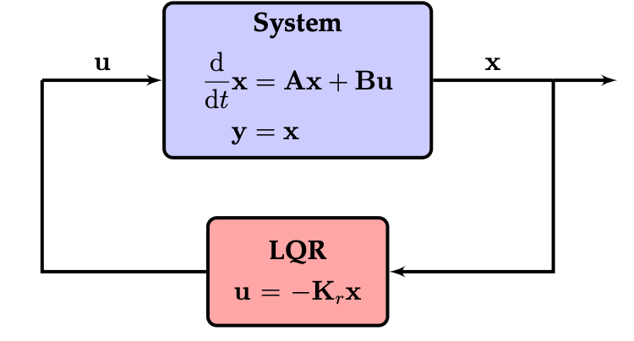
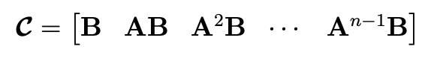
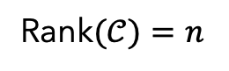
Linear System and Linear Control
Controllability: reach any state I want
Rank$(𝒞)=n$
2021 Brunton & Kutz

Slide 6
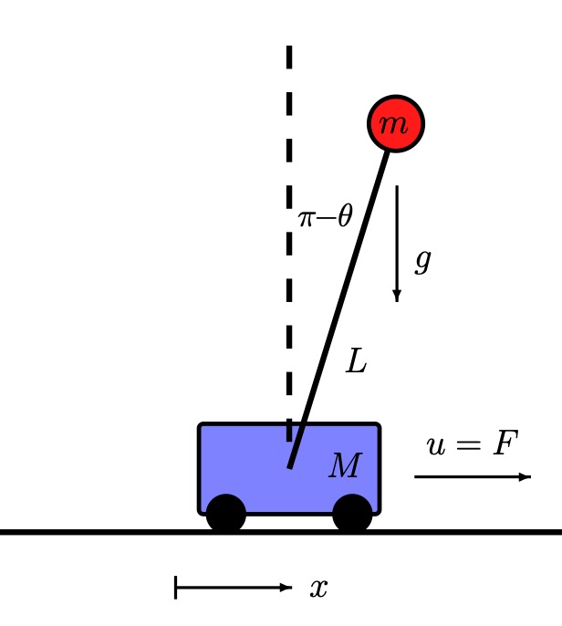
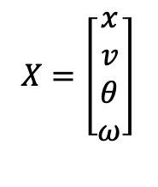
Linear System and Linear Control
Controllability: reach any state I want
Rank$(𝒞)=n$
$$X=\left[\begin{matrix}x \\ v \\ θ \\ ω\end{matrix}\right]$$
2021 Brunton & Kutz

Slide 7
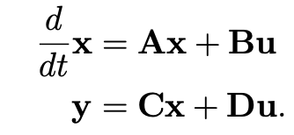
Linear System and Linear Control
Controllability: reach any state I want
Rank$(𝒞)=n$
$$X=\left[\begin{matrix}x \\ v \\ θ \\ ω\end{matrix}\right]$$
2021 Brunton & Kutz

Slide 8
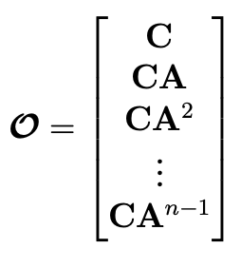
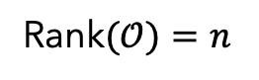
Linear System and Linear Control
Controllability: reach any state I want
Rank$(𝒞)=n$
Observability: estimate any state I want
$$X=\left[\begin{matrix}x \\ v \\ θ \\ ω\end{matrix}\right]$$
Rank$(𝒪)=n$
2021 Brunton & Kutz

Slide 9
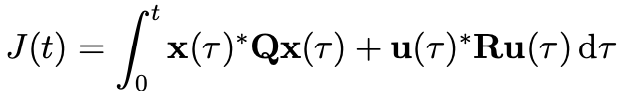
Linear Quadratic Regulator
Cost function
2021 Brunton & Kutz

Slide 10
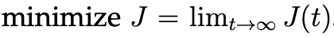

Linear Quadratic Regulator
Cost function
Design $K_{r}$to minimize
2021 Brunton & Kutz

Slide 11
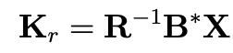
Linear Quadratic Regulator
Cost function
Design $K_{r}$to minimize
2021 Brunton & Kutz

Slide 12
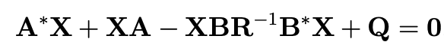
Linear Quadratic Regulator
Cost function
Design $K_{r}$to minimize
2021 Brunton & Kutz

Slide 13
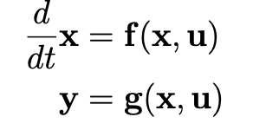
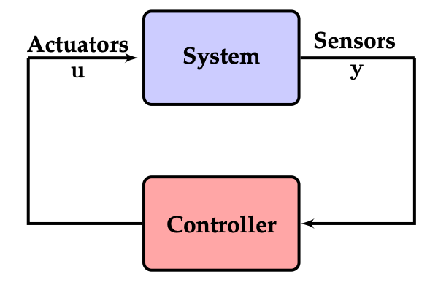
Data-Driven Control
2021 Brunton & Kutz

Slide 14
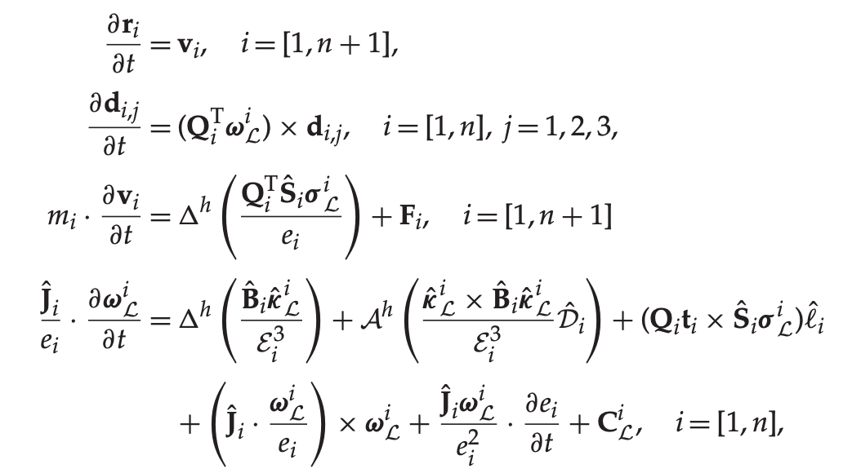
Data-Driven Control
Nonlinear system
Linear system
2021 Brunton & Kutz

Slide 15
Data-Driven Control
Challenges:
Nonlinear Dynamics
Unknown Dynamics
High dimensional
2021 Brunton & Kutz

Slide 16

Data-Driven Control
Data-Driven model:
Linearize non-linear model(Koopman operator)
Learn model from data(SINDYc, DMDc)
2021 Brunton & Kutz

Slide 17
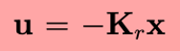
Data-Driven Control
Data-Driven model:
Linearize non-linear model(Koopman operator)
Learn model from data(SINDYc, DMDc)
Learn Control Policy
Naughton, Noel, et al. (2021)

Slide 18
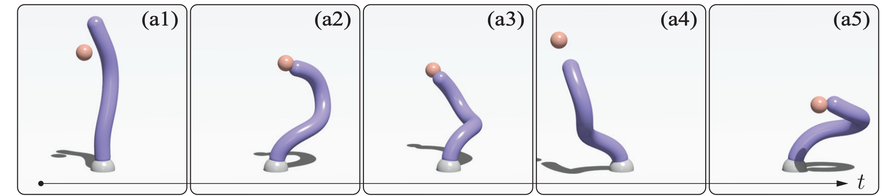
Data-Driven Control
Data-Driven model:
Linearize non-linear model(Koopman operator)
Learn model from data(SINDYc, DMDc)
Learn Control Policy
Naughton, Noel, et al. (2021)

Slide 19
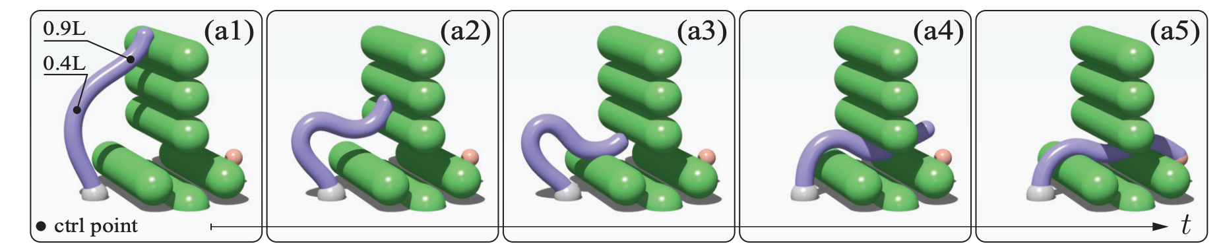
Data-Driven Control
Data-Driven model:
Linearize non-linear model(Koopman operator)
Learn model from data(SINDYc, DMDc)
Learn Control Policy
Naughton, Noel, et al. (2021)

Slide 20
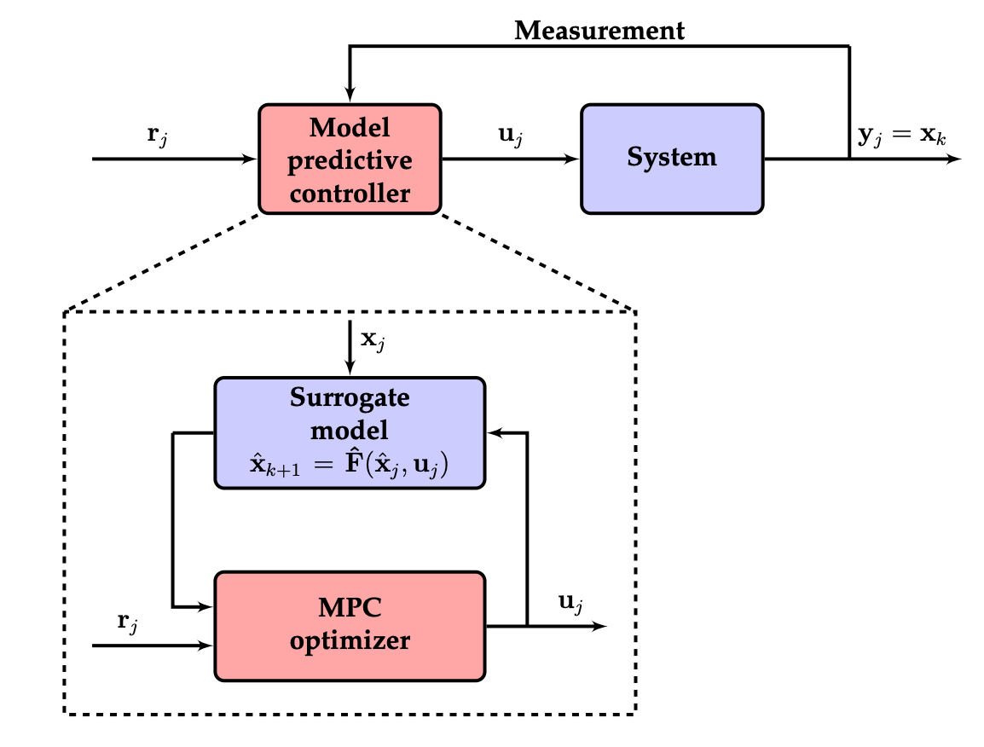
Model Predictive Controller(MPC)
2021 Brunton & Kutz

Slide 21
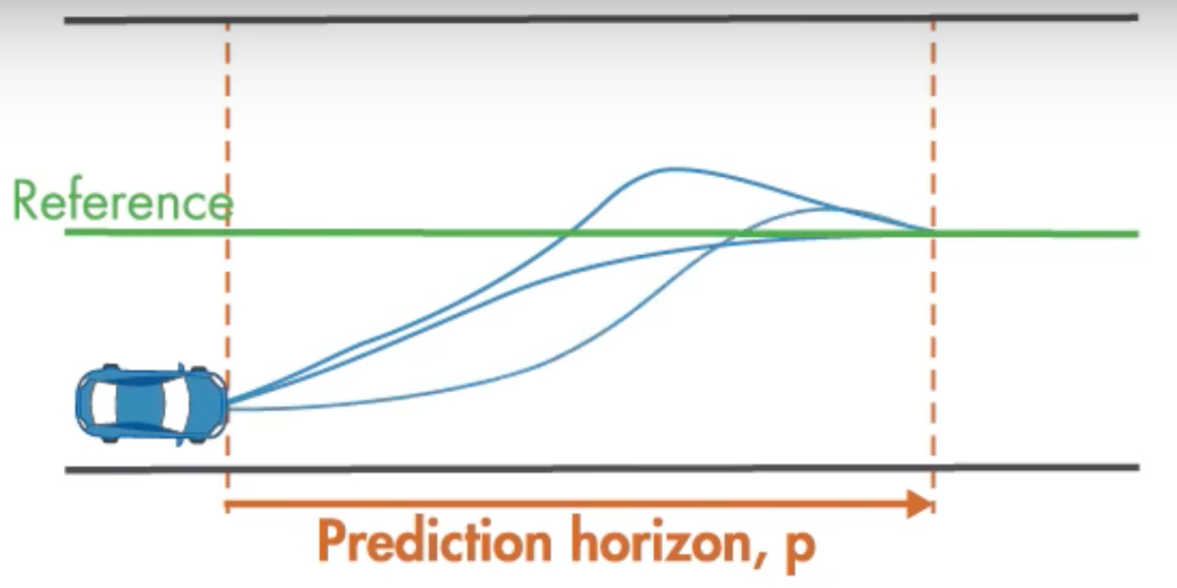
Model Predictive Controller(MPC)
2021 Brunton & Kutz

Slide 22
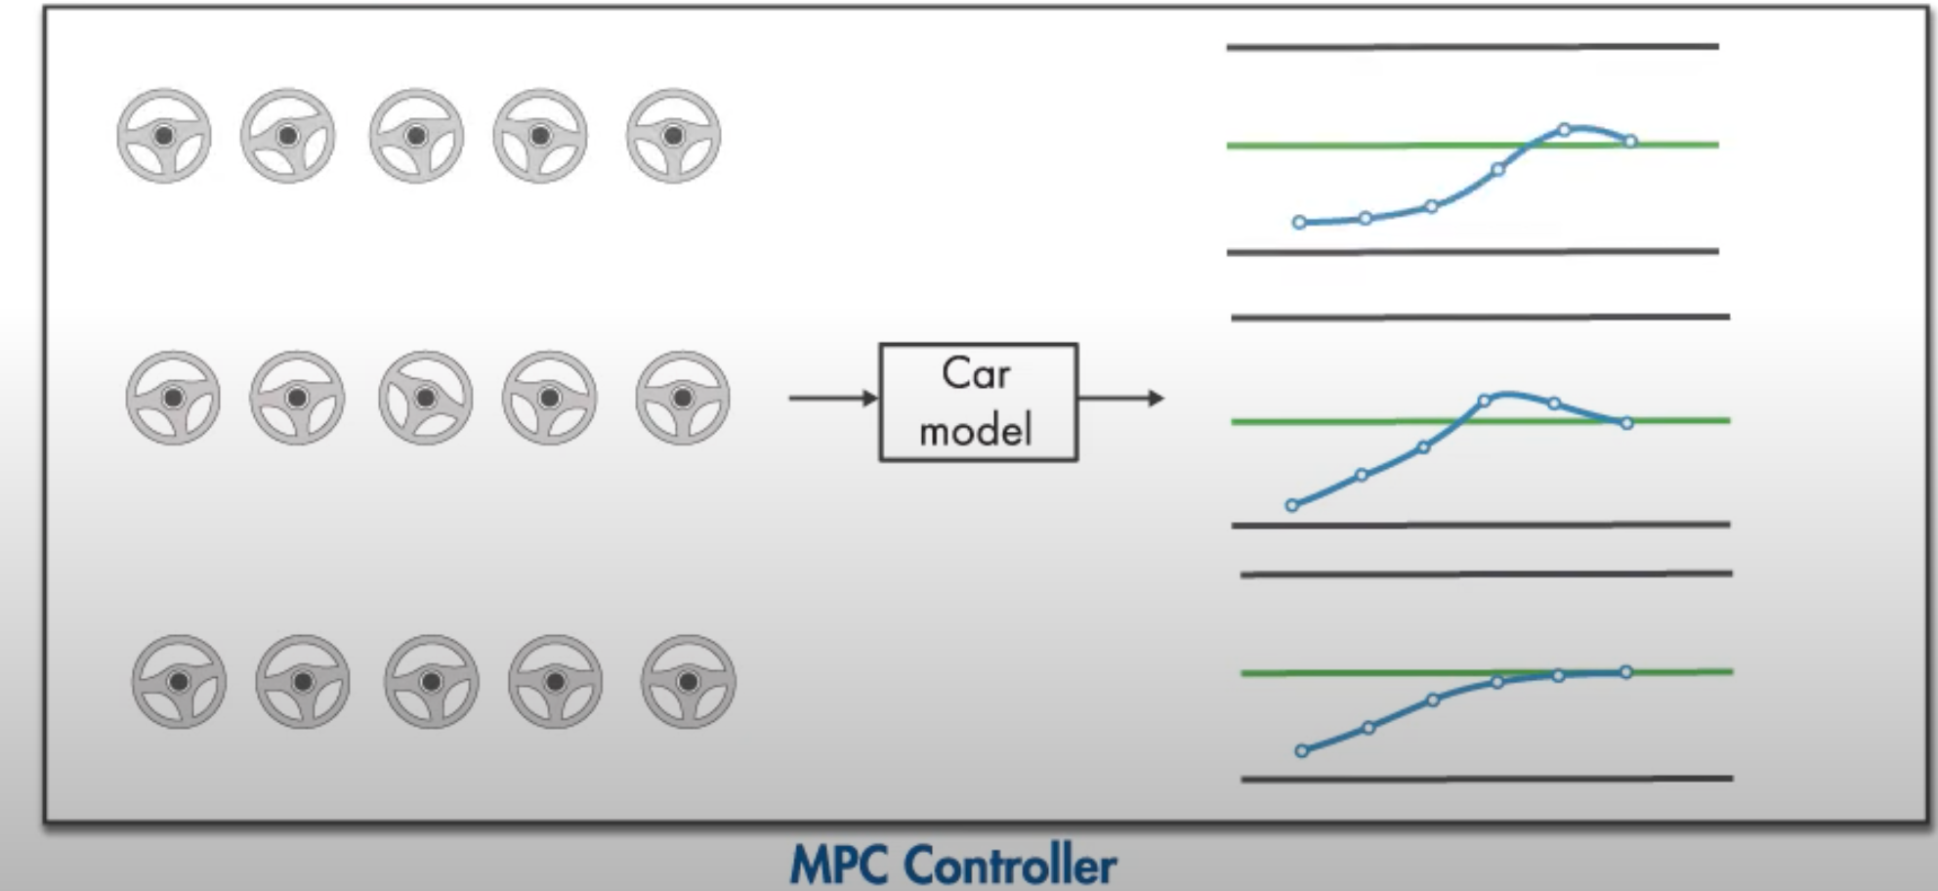
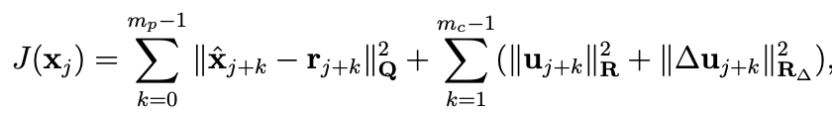
Model Predictive Controller(MPC)
2021 Brunton & Kutz

Slide 23
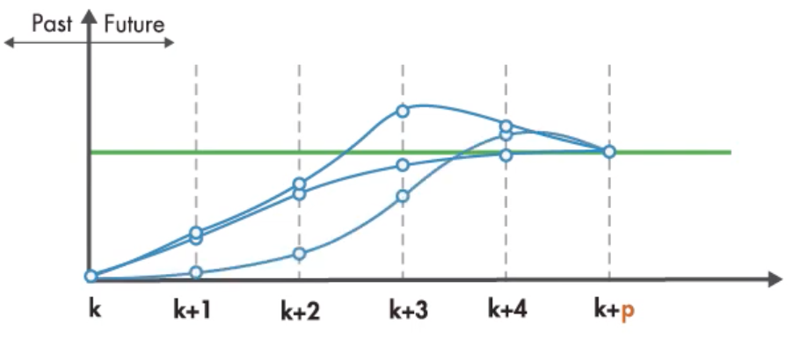
Model Predictive Controller(MPC)
2021 Brunton & Kutz

Slide 24
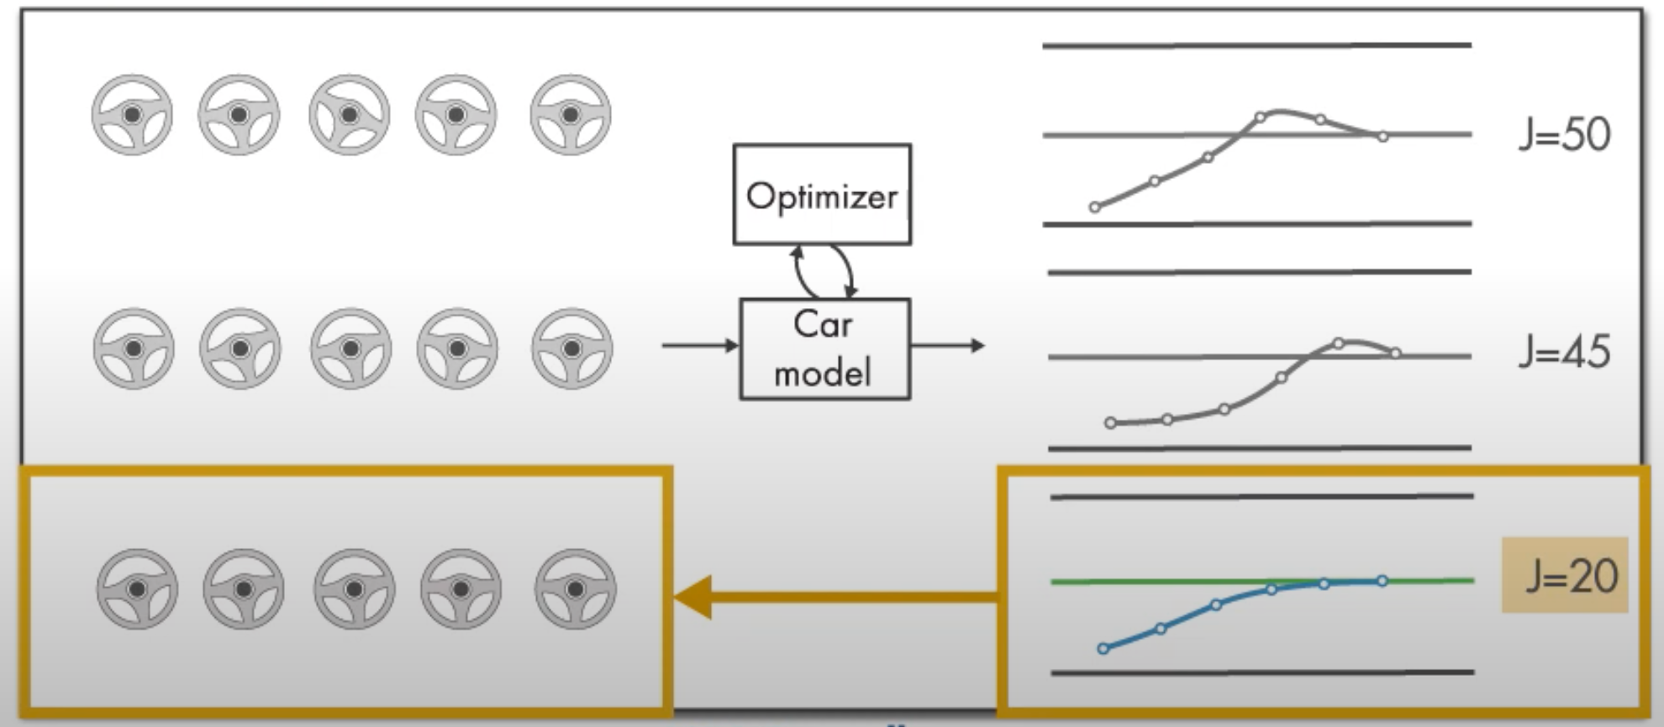
Model Predictive Controller(MPC)
2021 Brunton & Kutz

Slide 25
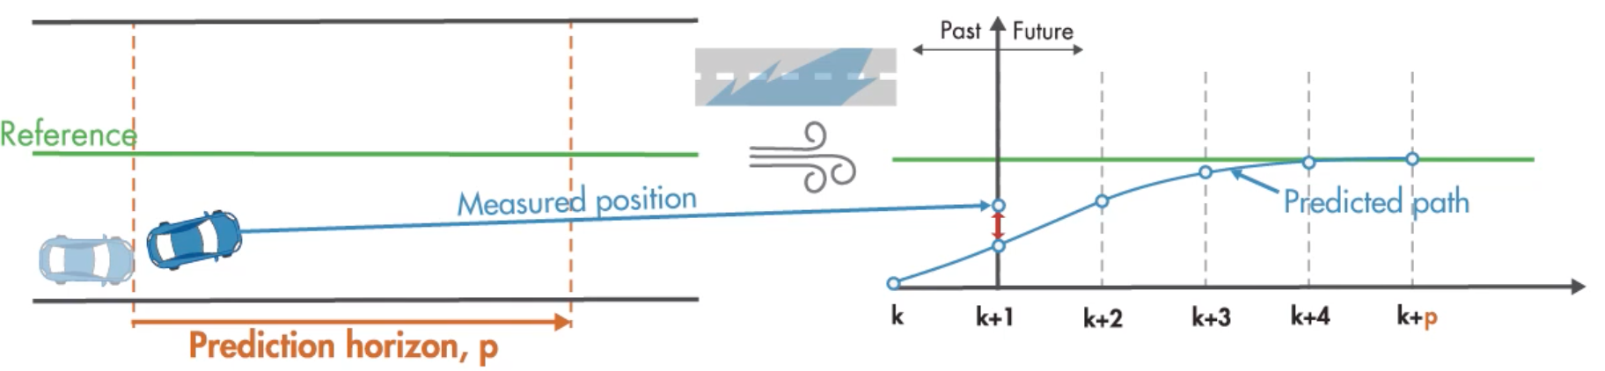
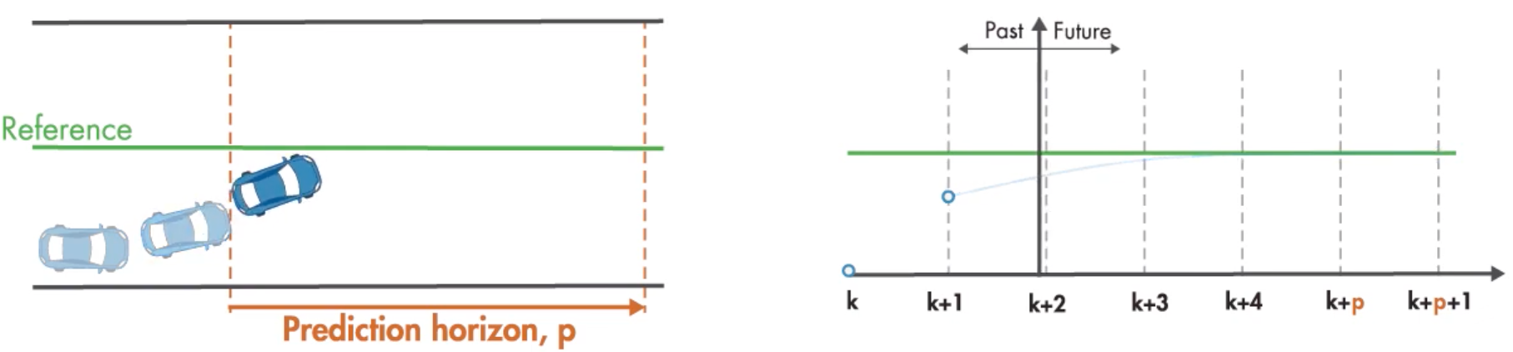
Model Predictive Controller(MPC)
2021 Brunton & Kutz

Slide 26
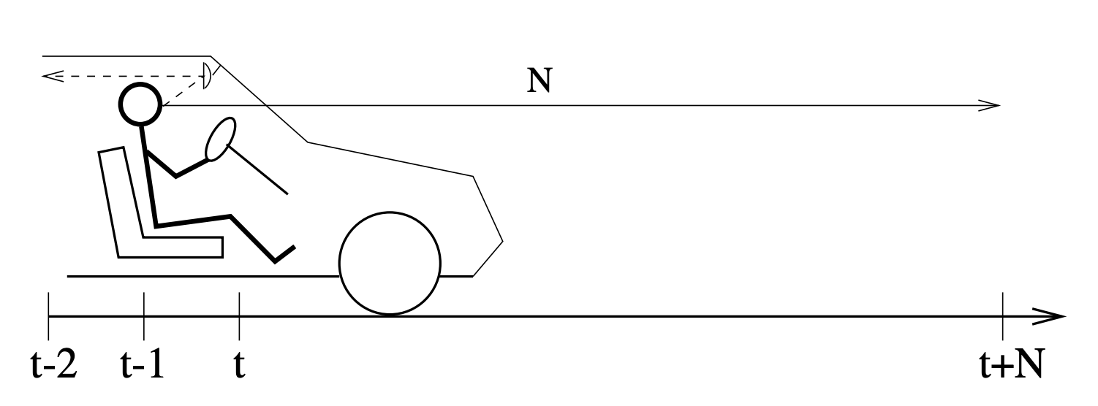
Model Predictive Controller(MPC)
PID and MPC
2007 E. F. Camacho , C. Bordons

Slide 27
Model Predictive Controller(MPC)
Challenges:
Fast Predictor
Online optimization
2007 E. F. Camacho , C. Bordons

Slide 28
Overview
Singular Value Decomposition(SVD) on PyElastica
Model Reduction: Sparse identification of nonlinear dynamical(SINDY)

Slide 29
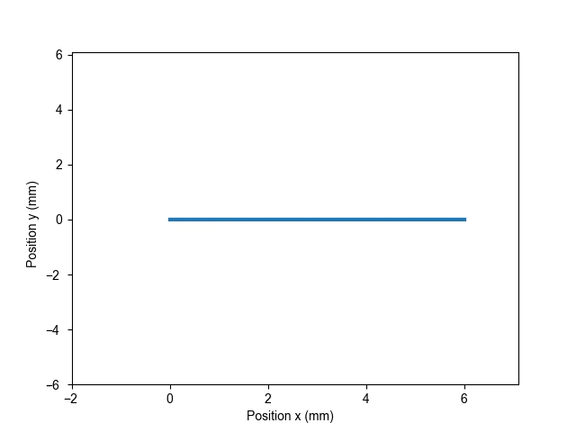
PyElastica Data

Slide 30
PyElastica Data

Slide 31
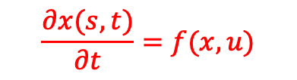
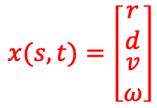
PyElastica Data
$$x(s,t)=\left[\begin{matrix}r \\ d \\ \begin{matrix}v \\ ω\end{matrix}\end{matrix}\right]$$
$$\frac{∂x(s,t)}{∂t}=f(x,u)$$

Slide 32
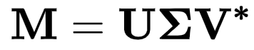
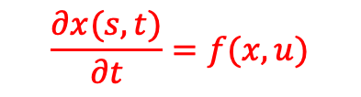
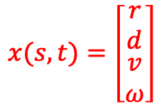

Singular Value Decomposition(SVD) on PyElastica
$$x(s,t)=\left[\begin{matrix}r \\ d \\ \begin{matrix}v \\ ω\end{matrix}\end{matrix}\right]$$
$${(n}_{var}∗n_{elem},t_size)$$
$$\frac{∂x(s,t)}{∂t}=f(x,u)$$

Slide 33

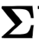
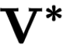



Singular Value Decomposition(SVD) on PyElastica
$$x(s,t)=\left[\begin{matrix}r \\ d \\ \begin{matrix}v \\ ω\end{matrix}\end{matrix}\right]$$
$${(n}_{var}∗n_{elem},t_size)$$
$$\frac{∂x(s,t)}{∂t}=f(x,u)$$
$${(n}_{var}∗n_{elem},n_{var}∗n_{elem})$$
$${(n}_{var}∗n_{elem},t_size)$$
$$(t_size,t_size)$$

Slide 34
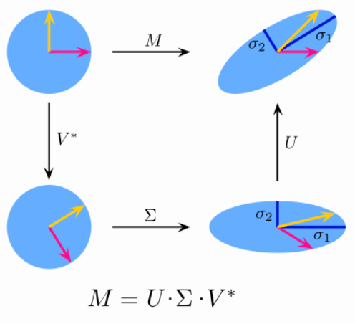
Singular Value Decomposition(SVD) on PyElastica
$$x(s,t)=\left[\begin{matrix}r \\ d \\ \begin{matrix}v \\ ω\end{matrix}\end{matrix}\right]$$
$${(n}_{var}∗n_{elem},t_size)$$
$$\frac{∂x(s,t)}{∂t}=f(x,u)$$
$${(n}_{var}∗n_{elem},n_{var}∗n_{elem})$$
$${(n}_{var}∗n_{elem},t_size)$$
$$(t_size,t_size)$$

Slide 35
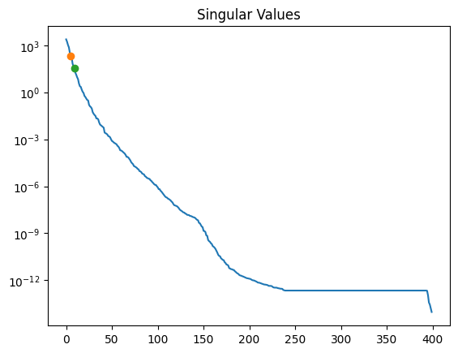
Singular Value Decomposition(SVD) on PyElastica
$$x(s,t)=\left[\begin{matrix}r \\ d \\ \begin{matrix}v \\ ω\end{matrix}\end{matrix}\right]$$
$${(n}_{var}∗n_{elem},t_size)$$
$$\frac{∂x(s,t)}{∂t}=f(x,u)$$
$${(n}_{var}∗n_{elem},n_{var}∗n_{elem})$$
$${(n}_{var}∗n_{elem},t_size)$$
$$(t_size,t_size)$$

Slide 36
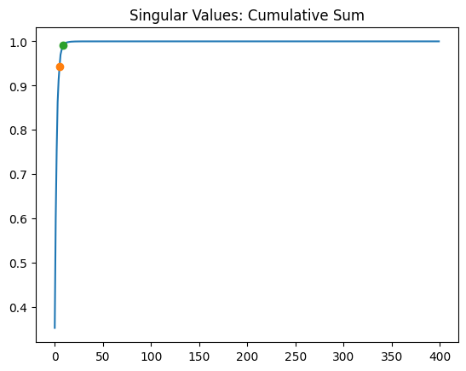
Singular Value Decomposition(SVD) on PyElastica
$$x(s,t)=\left[\begin{matrix}r \\ d \\ \begin{matrix}v \\ ω\end{matrix}\end{matrix}\right]$$
$${(n}_{var}∗n_{elem},t_size)$$
$$\frac{∂x(s,t)}{∂t}=f(x,u)$$
$${(n}_{var}∗n_{elem},n_{var}∗n_{elem})$$
$${(n}_{var}∗n_{elem},t_size)$$
$$(t_size,t_size)$$

Slide 37
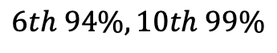
Singular Value Decomposition(SVD) on PyElastica
$$x(s,t)=\left[\begin{matrix}r \\ d \\ \begin{matrix}v \\ ω\end{matrix}\end{matrix}\right]$$
$${(n}_{var}∗n_{elem},t_size)$$
$$\frac{∂x(s,t)}{∂t}=f(x,u)$$
$${(n}_{var}∗n_{elem},n_{var}∗n_{elem})$$
$${(n}_{var}∗n_{elem},t_size)$$
$$(t_size,t_size)$$
$$6th 94\%, 10th 99\%$$

Slide 38
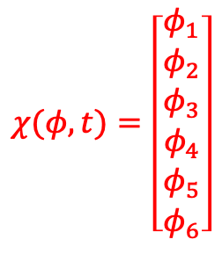
Singular Value Decomposition(SVD) on PyElastica
$$χ(φ,t)=\left[\begin{matrix}φ_{1} \\ φ_{2} \\ \begin{matrix}φ_{3} \\ \begin{matrix}φ_{4} \\ φ_{5} \\ φ_{6}\end{matrix}\end{matrix}\end{matrix}\right]$$
$$x(s,t)=\left[\begin{matrix}r \\ d \\ \begin{matrix}v \\ ω\end{matrix}\end{matrix}\right]$$
$${(n}_{var}∗n_{elem},t_size)$$
$$\frac{∂x(s,t)}{∂t}=f(x,u)$$
$${(n}_{var}∗n_{elem},n_{var}∗n_{elem})$$
$${(n}_{var}∗n_{elem},t_size)$$
$$(t_size,t_size)$$
$$6th 94\%, 10th 99\%$$

Slide 39
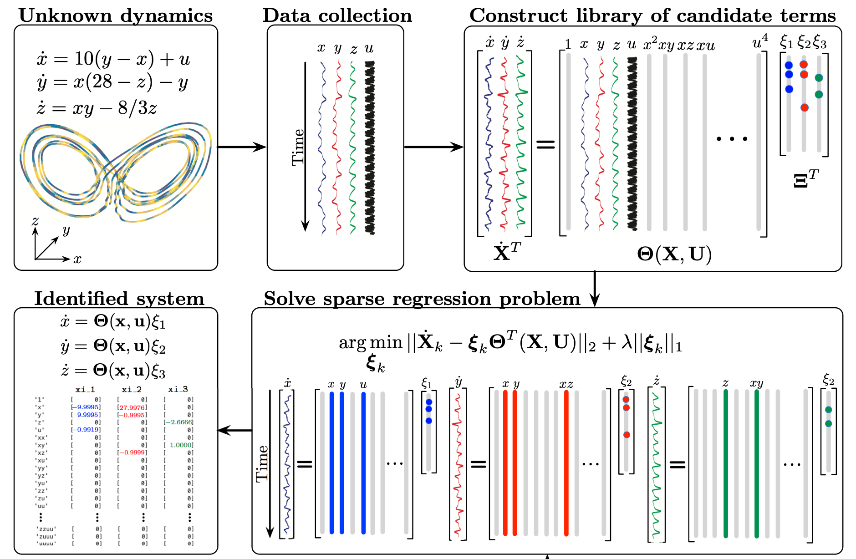
Sparse identification of nonlinear dynamical(SINDY)

Slide 40
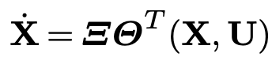
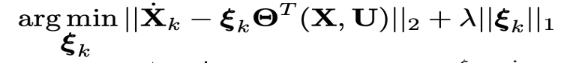
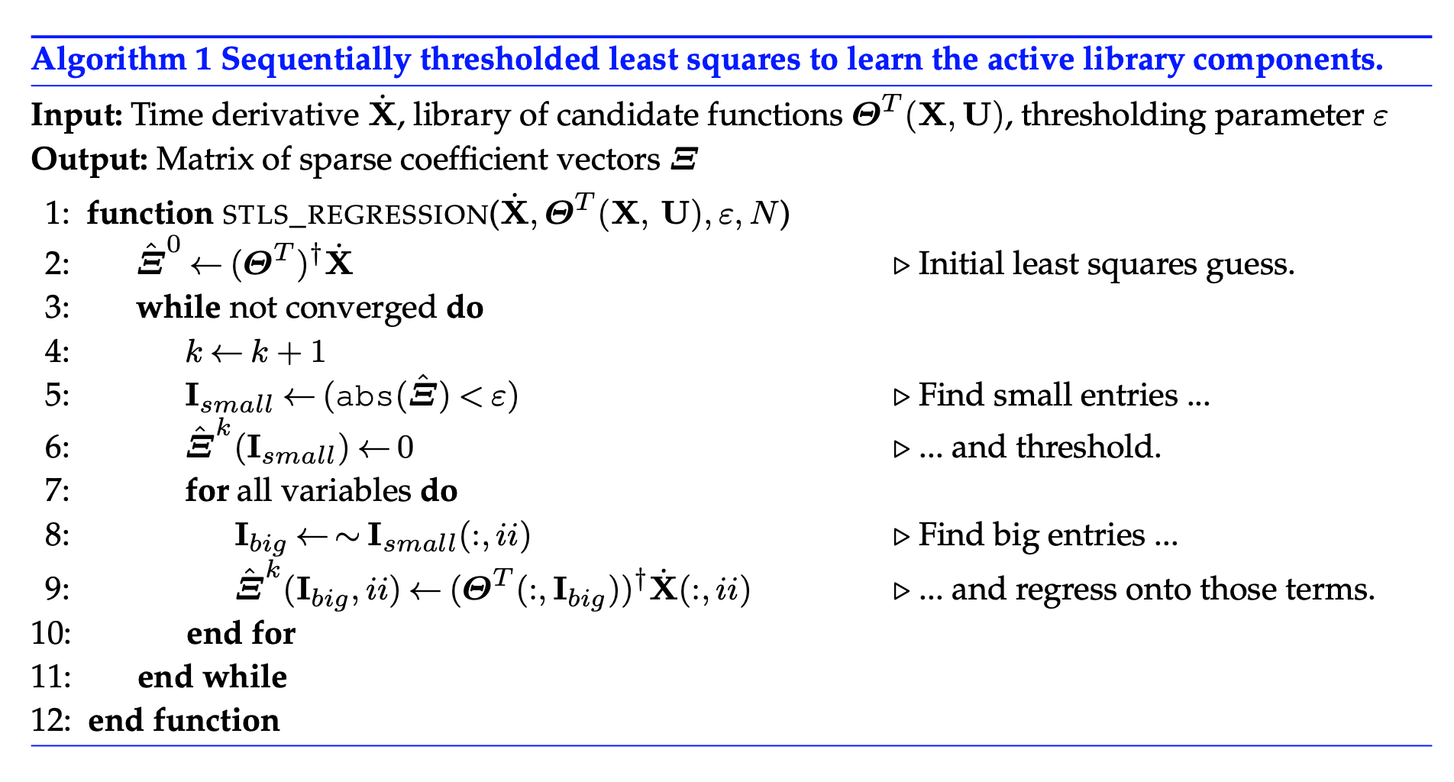
Sparse identification of nonlinear dynamical(SINDY)

Slide 41
Sparse identification of nonlinear dynamical(SINDY)

Slide 42
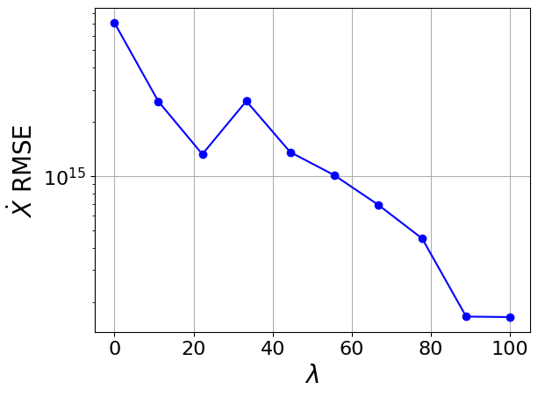
Sparse identification of nonlinear dynamical(SINDY)
Polynomial library
Wrong library?

Slide 43
Sparse identification of nonlinear dynamical(SINDY)
Polynomial library

Slide 44
Remark
Singular Value Decomposition(SVD) on PyElastica
Model reduction: Sparse identification of nonlinear dynamical(SINDY)

Slide 45
Outlook
Model reduction: Sparse identification of nonlinear dynamical(SINDY)
PyElastica Simulation

